Slide 1
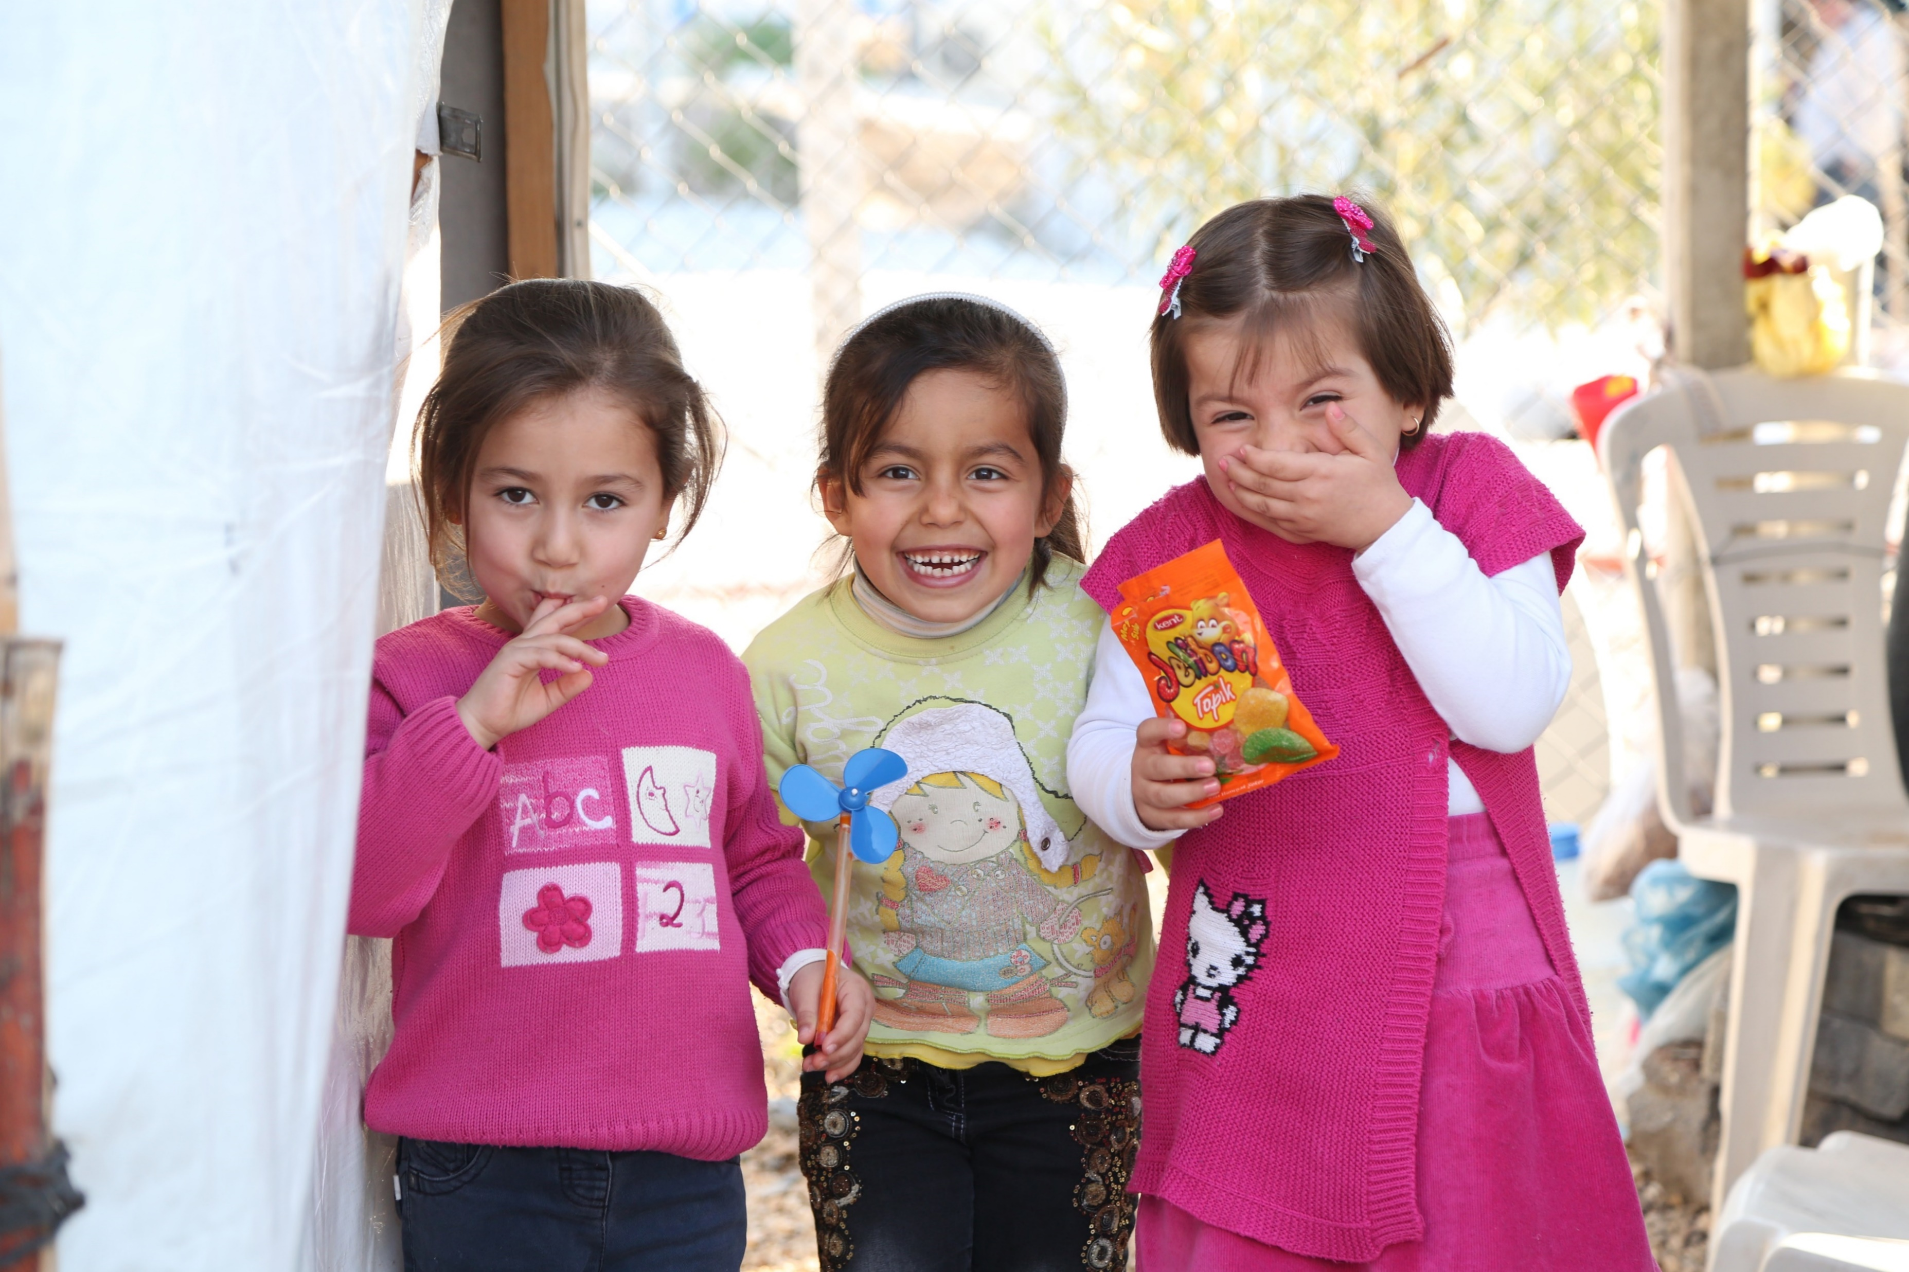
Government of Turkey – UNICEF
2021-2025 Country Programme
Child Intersectoral Meeting
29 June 2021

Slide 2
The Country Programme Framework
10th NDP, UNDCS, SDGs, UNICEF SP 2018-2021
11th NDP, UNSDCF, SDGs, UNICEF SP 2022-2025
Country Programme 2016-2020
Country Programme 2021-2025
Equity through social inclusion and resilience-building;
Enhanced learning, nurturing, care and development for young children
Quality data, knowledge and advocacy for child rights;
Enhanced learning and skills building for adolescents and young people
Total Throughput:
USD 787 M (RR, OR, ORE)
Total Planned Value:
USD 415M (RR, OR, ORE)
Protective and inclusive environment for the most vulnerable children
Gender equality among children and adolescents; and
Turkey-UNICEF expanded partnership beyond borders.
Investments and monitoring mechanisms for child rights
Humanitarian Response
UNICEF uses a humanitarian-development nexus approach which integrates the response to the urgent needs of refugee children across the four outcomes, and prioritizes social cohesion as well as their integration into national education, child protection, health and social protection systems.
Notes:
UNICEF Turkey Country Programme. This Country Programme has a transformative and ambitious vision, seeking to accelerate the realization of rights for the most vulnerable children in Turkey by reducing their exposure to violence and deprivation, and ensuring equitable access to inclusive and quality services.
Maintain progress achieved for children and accelerate results to reduce remaining gaps
Ensure systems are equitable and policy implementation reaches the most vulnerable
Adopt an integrated approach to respond to age-specific issues and promote multi-sectoral and holistic policies and programmes
Leverage the commitments of a broader group of stakeholders for more investment in child rights
Key Outputs 2016-2020 CPD:
Outcome 1 - Formal education for children, Quality inclusive education, Community-based child protection services, Social protection and resilience, Justice for Children, Adolescent engagement & social cohesion
Early Childhood Development, Multi-sectoral interventions for refugee & migrant children in critical locations, Child care system strengthening and CCTE/CP
Outcome 2 -Quality evidence, Independent CRM / Access to Justice
Outcome 3 - Education opportunities for adolescents, GBV and Child Marriage
Outcome 4 - Expanded partnership for children
EVOLUTION TO:
Key Outputs 2021-2025 CPD:
Outcome 1 - Nurturing Care, Quality and inclusive ECE services, Education system and primary education
Outcome 2 - Secondary education, Skills development, Adolescent development and participation
Outcome 3 - Social protection systems, Child protection, Justice for Children, Multi-sectoral community based support
Outcome 4 - National capacity for evidence generation, Investments for Children, Independent CRM

Slide 3
Key COVID 19 Priorities
Sustaining access to education for the most vulnerable children and bridging the "digital divide"
Addressing violence against children and women
Risk communication
Promoting the engagement of adolescents and young people in pandemic response
"Building back better" through systems strengthening

Slide 4
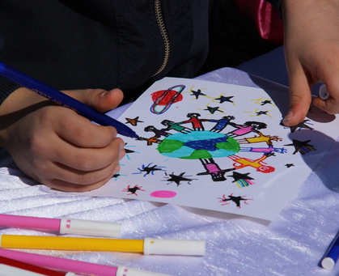
Key Priorities and Workplan Highlights
for 2021-2022

Slide 5
Partnerships
A) Government Authorities B) Civil Society and Professional Organizations
Turkish Statistical Institute (TURKSTAT)
Union of Municipalities of Turkey
Gaziantep Metropolitan Municipality
Sanliurfa Metropolitan Municipality
Yuregir Municipality
Kilis Municipality
Ege University
Presidency of Strategy and Budget (PSB)
Turkish Grand National Assembly (TGNA)
Ministry of National Education (MoNE)
Ministry of Family and Social Services (MoFSS)
Ministry of Labour and Social Security
Ministry of Health (MoH)
Ministry of Youth and Sports (MoYS)
GAP Administration
Ministry of Justice
Justice Academy of Turkey
Ministry of Interior/DGMM
Ombudsperson Institution
Turkish Red Crescent (TRC)
Association of Asylum Seekers and Migrants (ASAM)
Development Foundation of Turkey (DFT)
Foundation for Youth and Sports
Union of Turkish Bar Associations/Bar Association
International Children’s Center (ICC)
Partnership Network on Prevention of VAC
KEDV (Foundation for the support of women's work)
ECHA (NGOs Network for Children with Disabilities)
Association for Combatting Poverty in Kilis (ACPU)
Hacettepe University, Institute of Population Studies
KOÇ University
Mother Child Education Foundation (AÇEV)
Maya Foundation
Support to Life (STL)
Genc Basari Egitim Vakfi
Habitat Association
ICHILD
COHAG
IYSA
Development Workshop
TESK

Slide 6
Outcome 1 – Young Children
Sustainable Development Goals 3, 4, 5, 10, 17
By 2025 more young children, especially the most vulnerable, benefit from learning, nurturing care and development at home and in their communities
Improved knowledge and skills to provide nurturing care to young boys and girls
Increasing Access to and Quality of ECE
Inclusive and quality primary education for the most vulnerable children

Slide 7
Outcome 1: Priorities & Workplan
Output 1.1 Key Priorities Workplan Focus
Integrated national strategy on Early Childhood Development (ECD)
Support drafting of a national ECD strategy document (PSB)
Strengthening inter-sectoral cooperation and coordination at all levels to support early detection and intervention programmes for developmental delay (MoH)
Supporting the health system to sustain high immunization coverage and increase capacity of parents and caregivers
Strengthening immunization coverage by health system in areas with high presence of refugee children (including COVID 19 vaccination) (MoH)
Enhancing Family Strengthening Support Services (MoFSS)
Notes:
Key Priorities for 2021-2022 (Output1.1)
Supporting the development of an integrated national strategy on Early Childhood Development (ECD)
Supporting the health system capacity for high immunization coverage (including refugee children), infant and young child feeding(IYCF) best practices and early detection of the developmental delays
Support to Immunization:(Ministry of Health)
Strengthening the health system capacity to sustain high immunization coverage in areas with high presence of refugee children (including COVID 19 vaccination)
Early Childhood Development: ( PSB and MoH))
Development of national ECD policy: Support drafting of a national ECD strategy
document (PSB)
Strengthening inter-sectoral cooperation and coordination at all level within the ECD holistic approach and support the early detection and intervention programmes for development delay (MoH)

Slide 8
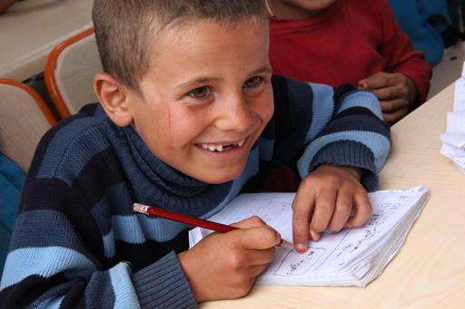
Outcome 1: Priorities & Workplan
Output 1.2 Key Priorities Workplan Focus
Access to quality early childhood learning
Expansion of flexible alternative ECE services and engagement with parents and families (MoNE)
Home- and community-based and mobile ECE services (Yuregir Muncipality, DFT, Union of Municipalities)
Public financing for Early Childhood Education
Evidence generation (Knowledge, Attitude and Practices (KAP) Study, ECE Investment Case Study, ECE Services Vulnerability Mapping) to leverage and strengthen ECE policy (MoNE)
Notes:
Increasing access to quality formal ECE services (IPA-II Project implemented through MoNE)
Expansion of flexible alternative ECE services, supply-side strengthening initiatives (curriculum revision, national standards development, and teaching and learning materials), and C4D engagement with parents and families
Home- and community-based and mobile ECE services (Yuregir, DFT/TKV, Union of Municipalities)
Summer School, Neighborhood Mothers Programme, Playrooms, Toy Libraries, First Six-Year Programme, Parental/Father Engagement Programme, Mobile ECE trucks, and strengthening ECE service provision in Municipalities
Generating evidence, and leveraging ECE policy improvements to strengthen ECE sub-sector (MoNE, institutional service providers managed by UNICEF)
Knowledge, Attitude and Practices (KAP) Study, ECE Investment Case Study, ECE Services Vulnerability Mapping

Slide 9
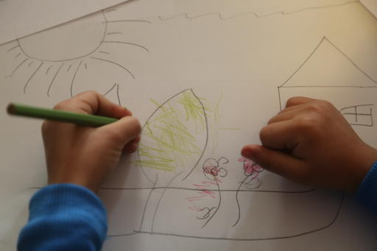
Outcome 1: Priorities & Workplan
Output 1.3 Key Priorities Workplan Focus
Support education system in light of impact of COVID 19
Strengthen education system, including learning support mechanisms, innovative learning opportunities and student assessment and monitoring (MoNE)
Support teacher capacity development and digital teaching and learning opportunities in F2F and hybrid settings (MoNE)
Evidence generation and policy strengthening on student learning achievement, including COVID-19 recovery and response (MoNE)
Awareness on education opportunities for refugees
Advocacy, awareness raising and coordination on education opportunities for refugee children (MoNE)
Notes:
Support for development of inclusive education programmes and provision of innovative learning environments in teaching, learning and children's well-being
Remedial Education, Blended Catch-up, Digital Special Education, Digital Measurement and Evaluation
Support teacher and Syrian Support Workers’ (SSWs) capacity development and implement innovative teaching and learning opportunities in F2F and hybrid settings
SSW Programme, Digital Teacher Training
Evidence generation and policy strengthening support on student learning achievement, including COVID-19 recovery and response
OECD Learning Achivement Gap Study, National Digital Strategy
Mental Health PSS, Teacher Training (Teaching Basic Literacy and Numeracy in Blended Settings, Safe School Support)
Advocacy, awareness and communication of education opportunities (Syrian refugees, cash transfers, and coordination of EiE efforts)
Sector coordination 3RP, CCTE, Back to School

Slide 10
Outcome 2 – Adolescents and Young People
Sustainable Development Goals 4, 5, 10, 16
By 2025, the most vulnerable and at-risk adolescents and young people are learning, acquiring relevant skills, and participating meaningfully in an environment that is safe and responsive to the needs of both girls and boys
Access to quality formal education and learning outcomes for adolescents
Skills development for vulnerable adolescents in and beyond school settings
Increased knowledge of participatory and protective behaviors and practices among adolescents

Slide 11
Outcome 2 Priorities and Workplan Focus
Output 2.1 Key Priorities Workplan Focus
Quality learning opportunities in secondary education
Provision of resources, materials and services to increase access of adolescents, including those under temporary protection, to vocational and technical education opportunities (MoNE)
Support implementation of academic support programmes for adolescents at risk of drop out in secondary education (MoNE)
Referral mechanisms
Strengthen linkages with existing social protection programmes to support vulnerable adolescents and their families (MoNE; MoFSS)
Support referral mechanism for adolescents transitioning back into the formal education system (MoNE; MoFSS; MoYS; TRC; ASAM; STL; Municipalities)
Innovations in programming and advocacy for children
Advocate to strengthen and develop inclusive education policies and support for improved coordination mechanisms (MoNE)
Notes:
Investing in quality learning opportunities in formal secondary education for vulnerable and at-risk adolescents (MoNE)
Strengthen formal education learning environment for adolescents by identifying barriers, monitoring enrollment, attendance and completion
Develop, implement and monitor programmes to increase attendance rates and prevent early school leaving at upper secondary level
Support provision of resources, materials and services to increase access of adolescents, including those under temporary protection, to vocational and technical education opportunities
Support implementation of academic support programmes for adolescents at risk of drop out in secondary education
Demand-side programming to enhance the availability of education programmes (MoNE; MoFSS; MoYS; TRC; ASAM; STL; Municipalities)
Strengthen linkages with existing social protection programmes that support vulnerable adolescents and their families to adopt positive coping mechanisms
Support referral mechanisms to alternative learning pathways for both boys and girls with the intention for transitioning back into the formal education system
Foster innovations in programming and advocacy for children (MoNE)
Advocate to strengthen and develop inclusive education policies and support for improved coordination mechanisms

Slide 12
Outcome 2 Priorities and Workplan Focus
Output 2.2 Key Priorities Workplan Focus
Skills development for adolescents and young people
Development of a harmonized approach (national standards) to skills development (MoNE, MoYS)
Using social innovations to build adolescent skills and promote social cohesion (MoYS, YSF, IYSA, Genc Basari, TKV, GAP, Maya Foundation)
Delivery of 21st century skills training through youth centers
(MoYS; TRC; ASAM; STL; YSF, IYSA, Genc Basari, )
Reimagine Education
Digitalized learning opportunities and IT-enabled solutions to increase adolescents’ skills, improve teaching, and enhance the effectiveness and efficiency of the education system
(MoNE; MoYS)
Alternative learning pathways
Implementation of the Accelerated Learning Program (MoNE)
Turkish language courses and education support programs for OOS and at-risk children
(MoNE; MoYS; TRC; ASAM; STL; Municipalities)
Notes:
Support skills development among adolescents and young people for their personal empowerment, civic engagement, and school-to-work transition (MoNE; MoFSS; MoYS; TRC; ASAM; STL; YSF, IYSA, Genc Basari, Maya Foundation)
Development of a harmonized approach (national standards) to skills development for adolescents and adoption
by government and NGO partners to promote resilience and social cohesion in schools and the larger community
Roll out of adolescent and youth skills building through social innovations (UPSHIFT)
Skills delivery through youth centres (Arts, computing, robotics etc.)
Reimagine Education (MoNE; MoYS; partners)
Digitalized learning opportunities and IT-enabled solutions to boost adolescents' skills, improve teaching, and enhance the effectiveness and efficiency of the education system
Expansion of alternative learning pathways (MoNE; MoYS; TRC; ASAM; STL; Municipalities)
Accelerated Learning Programme
Turkish Language Courses and education programmes to reintegrate OOSC children into the education system

Slide 13
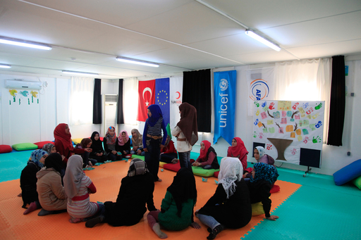
Outcome 2 Priorities and Workplan Focus
Output 2.3 Key Priorities Workplan Focus
Adolescents and young people's participation
Expansion of platforms for volunteerism and other mechanisms to increase engagement and participation of young people
Youth communication, knowledge sharing and engagement (MoFLSS, MOYS, GAP)
Community mobilization to prevent child/early marriage
Empowering girls and boys through skills building and mentorship programs
Promoting positive role models and intergenerational dialogue
(MoFSS, AÇEV, GAP, ASAM, TRC, Municipalities)
Promoting positive social norms to prevent violence against women and girls
Notes:
Communicating and engaging (C4D) with young people
-Capacity building for young people’s communication and engagement (Vlogging/ Blogging activities)
-Promote young people’s participation among parents, service providers and decision makers
Support to adolescent & young people's participation (MoFLSS, MOYS, GAP)
- Expansion of platforms for volunteerism and other mechanisms to increase engagement and participation of young people e.g., Mahalle Support Mechanism
-National (e.g., Child Rights Committees and Advisory Board) / Regional platforms
-Youth communication and engagement: Vlogging/ Blogging activities
-Knowledge sharing on youth issues as part of 'International UN Youth Centre' activities
Promoting positive social norms for preventing child marriage and gender based violence (MoFSS, AÇEV, GAP, ASAM, TRC, Municipalities)
- Girls and boys' empowerment through skills building and mentorship programmes
- Communication for Social and Behavioral Change (C4D) targeting families and communities
- Promoting positive role models and inter-generational dialogue

Slide 14
Outcome 3 – Protective and Inclusive Environment for the most vulnerable
Sustainable Development Goals 1, 5, 10, 16
By 2025, vulnerable children and families benefit from improved child protection and social protection services
Child-sensitive social protection system
Strengthened child protection system
Child-friendly justice system

Slide 15
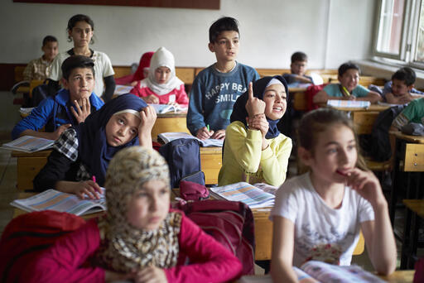
Outcome 3 Priorities and Workplan Focus
Output 3.1 Key Priorities Workplan Focus
Child sensitive social policy and program development
Implementation and coordination of the CCTE Programme for Refugees (MoFSS)
Strengthening the shock responsiveness and child sensitivity of social protection systems at at national and local level by improving social assistance selection, targeting, inquiry, decision-making and monitoring tools. (MoFSS)
Social protection system strengthening
Strengthening linkages and cross sectoral integration between social assistance and social services (child protection, family, community services) (MoFSS)
Information systems strengthening to improve analytical and operational capacities of Integrated Social Assistance System (MoFSS)
Notes:
Implementation and coordination of the CCTE Programme for Refugees
Increasing the shock-responsiveness and child-sensitivity of social protection system at central and local levels
Improving linkages and integration between social assistance and social services (child protection, family, community services) on the basis of Cash+ Programming Principles
Data/MIS Systems Strengthening to improve analytical and operational capacity of ISAIS

Slide 16
Outcome 3 Priorities and Workplan Focus
Output 3.2 Key Priorities Workplan Focus
Child Protection Systems Strengthening
Social service workforce capacity development, case management and normative frameworks. (MoFSS)
Preventive services: family and parenting support; alternative care system; family-based early intervention system for children with disabilities. (MoFSS)
Strengthening linkages between community-based protection services and the national system
Outreach capacity: ASDEP, CCTE CP, Children are Safe Programme, community-based services. (MoFSS)
Psychosocial support focusing on refugee and migrant children and their families and those affected by emergencies. (MoFSS)
Strengthening services on violence against women
Preventing domestic violence and CEFM and strengthening services for survivors (MoFSS)
Notes:
Systems Strengthening: Social service workforce, case management and normative frameworks
Preventive services: family and parenting support services; alternative care system; family-based early intervention system for CWD.
Outreach capacity: ASDEP, CCTE CP, Children are Safe Programme, community-based services.
Psychosocial support to vulnerable children and their families.
Strengthening preventive services for domestic violence and CEFM.

Slide 17
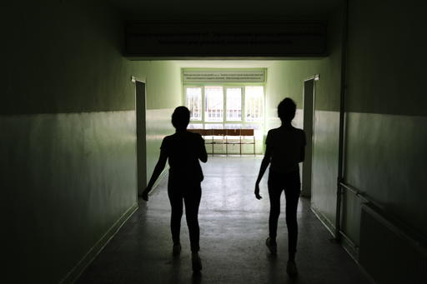
Outcome 3 Priorities and Workplan Focus
Output 3.3 Key Priorities Workplan Focus
Community based probation, diversion and restorative practices
Child-sensitive interventions concerning children in contact with law and Judicial Support Directorates (Ministry of Justice)
Community-based probation, diversion and restorative practices for children (Ministry of Justice)
Training for lawyers and Bar Associations on promotion, protection and monitoring of children's rights (Union of Turkish Bar Associations)
Development and dissemination of training curricula for candidate judges & prosecutors (Justice Academy of Turkey)
Capacity development
Notes:
Justice Sector Rolling Work Plan:
Child-sensitive interventions concerning children in contact with law and Judicial Support Directorates (Ministry of Justice)
Community-based probation, diversion and restorative practices for children (Ministry of Justice)
Increasing the capacity of lawyers and Bar Associations on promotion, protection and monitoring of children's rights (Union of Turkish Bar Associations)
Training curricula for candidate judges & prosecutors and development and publication of the new content (Justice Academy of Turkey)

Slide 18
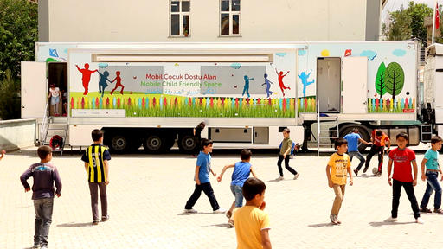
Outcome 3 Priorities and Workplan Focus
Output 3.4 Key Priorities Workplan Focus
Multisectoral coordination and child-oriented policy and strategy development (Gaziantep Metropolitan Municipality, Sanliurfa Metropolitan Municipality and Kilis Municipality, GAP, TKV, STL)
Youth skills building including employability (Gaziantep Metropolitan Municipality, Kilis Municipality, GAP, TKV)
Early Childhood Education for children from host and refugee communities - (Gaziantep Metropolitan Municipality, Sanliurfa Metropolitan Municipality and Kilis Municipality, GAP, TKV)
Identification and referral of OOS and at risk of drop-out children (Gaziantep Metropolitan Municipality, Kilis Municipality, Şanlıurfa Municipality, GAP, TKV, STL)
Awareness raising on Child,Early and Forced Marriage (Gaziantep Metropolitan Municipality, Kilis Municipality, GAP)
Complementary services for vulnerable groups
in Southeast Turkey
Notes:
Multisectoral coordination and child-oriented policy and strategy development – (Gaziantep Metropolitan Municipality, Sanliurfa Metropolitan Municipality and Kilis Municipality, GAP, TKV, STL)
Youth skills building including employability – Gaziantep Metropolitan Municipality and Kilis Municipality, GAP
Early Childhood Education for children from host and refugee communities - (Gaziantep Metropolitan Municipality, Sanliurfa Metropolitan Municipality and Kilis Municipality, GAP)
Identification and referral of OOS and at risk of drop-out children - Gaziantep Metropolitan Municipality and Kilis Municipality, GAP
Public campaign and awareness raising – Gaziantep Metropolitan Municipality

Slide 19
Outcome 4 – Investment and monitoring Mechanisms for Child Rights
Sustainable Development Goal 8, 10, 16, 17
By 2025, public and private entities and civil society demonstrate a shared commitment and increased investments in child rights
Evidence generation and use for policy and programmes for children
Increased investments for children through partnerships and engagement
Stronger awareness and accountability for child rights

Slide 20
Outcome 4 Priorities and Workplan Focus
Key Output Priorities Workplan Focus
Technical support on expanding availability and access to data, including publications of child focused data on SDGs (Turkstat, PSB, relevant Ministries)
Strengthening statistical literacy for children (Turkstat)
Data and evidence generation
Partnership and engagement with key stakeholders including private sector
Promoting child rights and business principles (CRBP) amongst private sector
Work in partnership with private sector to leverage resources to eliminate child labour (private sector, MoL, civil society)
Increasing strategic planning, budgeting, and resource allocation for children at central and local levels. (PSB, Union of Municipalities of Turkey)
Intersectoral dialogues and knowledge exchange to promote child rights
Strengthen the coordination and convening role of the Ombudsperson’s Institution (OI) and Parliament for better monitoring of violations and advocacy on child specific issues
Promote systematic dialogue between OI, Parliament, children's and youth organizations and other civil society organizations
International knowledge and experience exchange on independent child rights monitoring
Notes:
Technical and financial support to MoFSS and TurkStat for the content, methodology, analysis and dissemination of the national child research project funded by PSB
Strengthening statistical literacy for children viz a viz data visualization and publications of child focused data
Contributed to system strengthening in expanding availability and access to data, including child focus data on SDGs.
Statistical capacity development of TurkStat another relevant implementing partners at national and sub national levels
Contribute to official statistical program 2022 – 2026 by addressing data gaps on children
Support the Ministry of Labour and Social Security to implement the National Programme on the Elimination of Child Labour
Improving the preventive role of labour inspection and social protection against child labour
Promoting children's rights and business principles (CRBP) among private sector
Working with municipalities to build the capacities in strategic planning and budgeting for children; early childhood care & education; child-sensitive disaster risk reduction.
Ensuring systematic dialogue between the Ombudsperson’s Institution/Parliament and children's and youth organizations
Strengthening the coordination and convening role of OI/Parliament for better monitoring of violations, advocacy and redress.
Developing and disseminating child- friendly versions of relevant legislation
International knowledge and experience exchange to explore best practice on independent CRM.

Slide 21
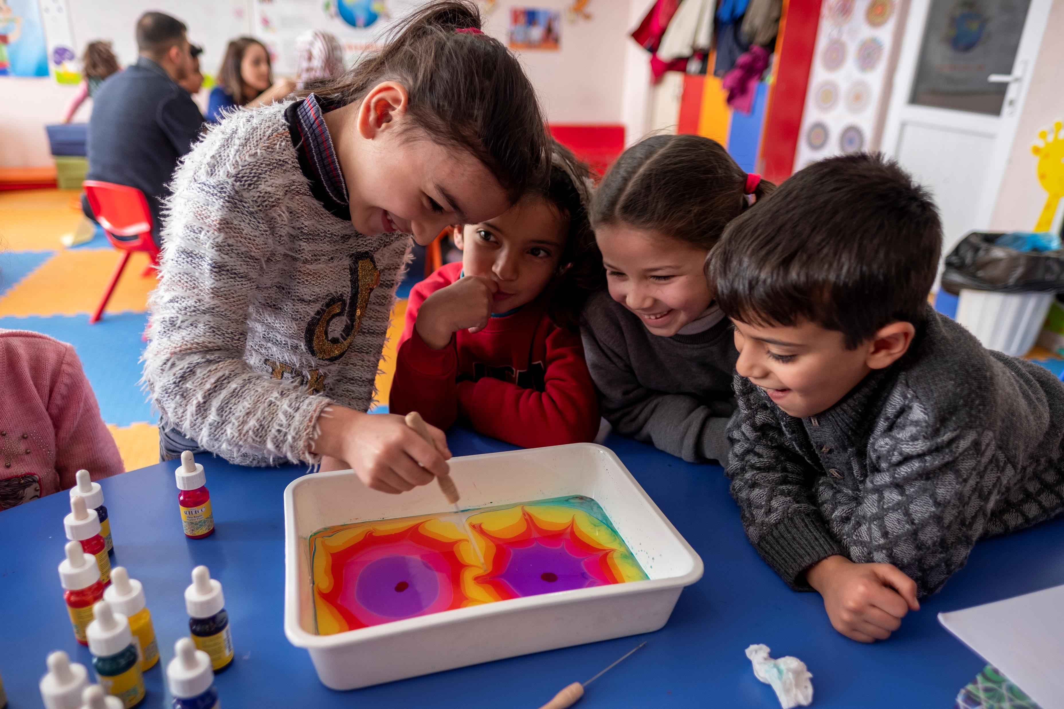
Thank you

Slide 22
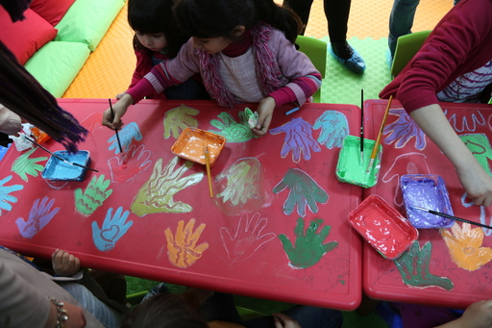
Q & A

